Slide 1
Networks: Communicating and Sharing Resources
Computer Literacy

Slide 2
Networks
Links multiple computer systems and enables them to share data and resources, using cables, radio waves, or infrared signals
Some types of networks, from smallest spanning to largest spanning:
Personal area network (PAN)
Local area network (LAN)
Campus area network (CAN)
Metropolitan area network (CAN)
Wide area network (WAN)

Slide 3
Communication Devices Terminology
Node
Network interface cards (NICs)
Modems
Routers
Switches
Hubs
Wireless access points (WAP)
Any device connected to a network
Expansion board or adapter that provides a connection between the computer and the network
Connect to your ISP
Connect two or more networks
Determine the best route to transmit data given source & destination
Filter and forward data between nodes
Similar to routers but work within a single network
Joins multiple computers together in a single network
Does not manage traffic between the connections
Joins wireless nodes to a wired network

Slide 4
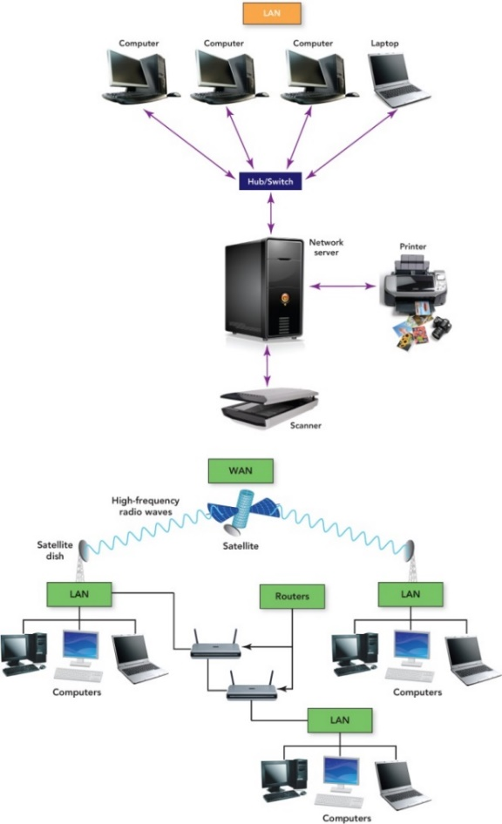
Networks Example: LAN vs. WAN
Notes:
T

Slide 5
Local Area Networks (LAN)

Slide 6
Type of LAN: Wireless LAN (WLAN)
Connects users through radio waves instead of wires
Use includes networks in:
Homes
Hospitals
Colleges
Secured with a radio transmission technique that spreads signals over a seemingly random series of frequencies.
Effective inside range of between 125 and 300 feet

Slide 7
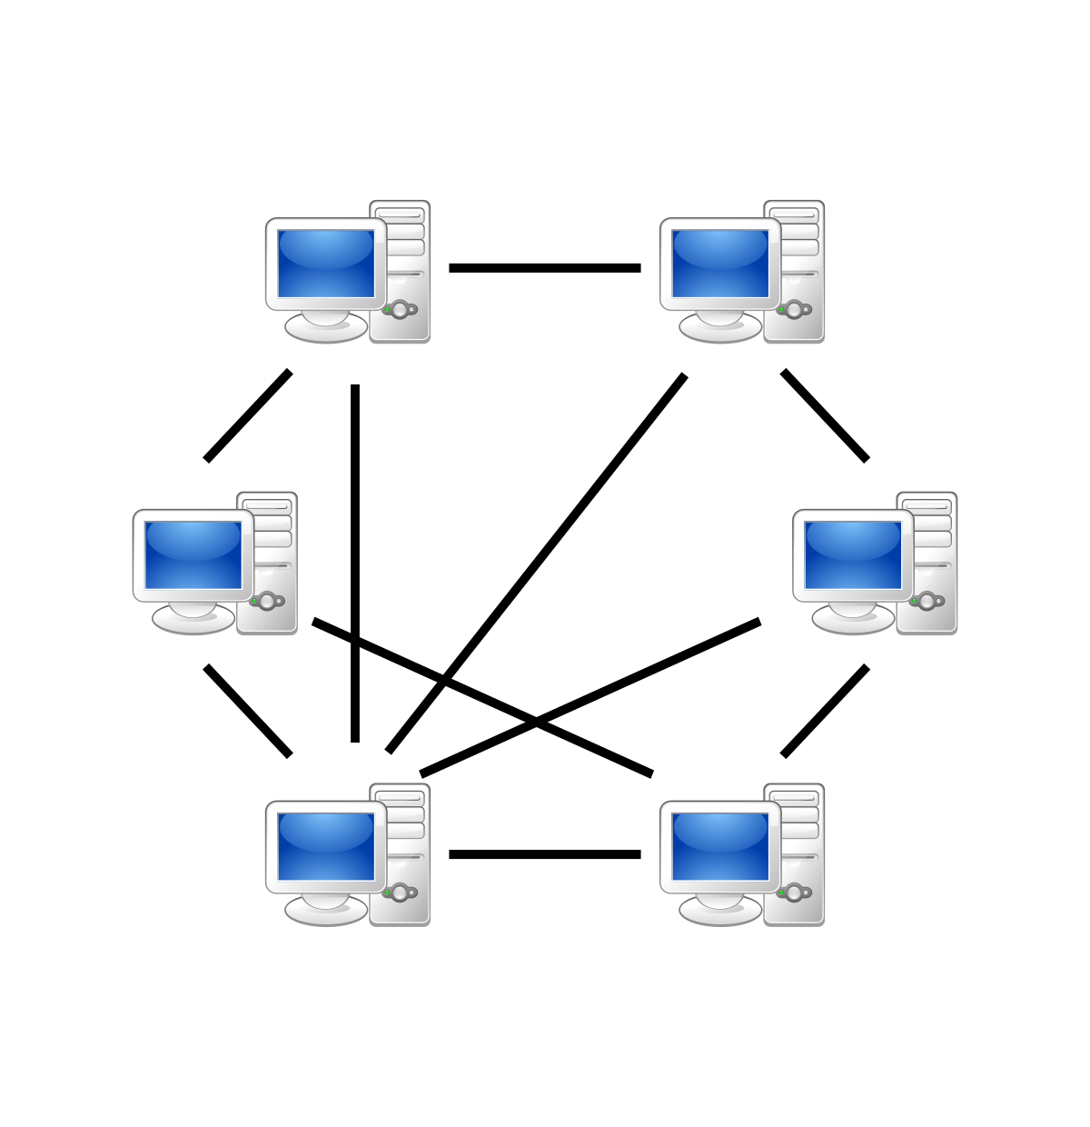
Type of LAN: Peer-to-peer (P2P) networks
Share files without a file server
Inexpensive to set up
Best used for home or small offices with no more than 10 computers
Do not require a network operating system
Can be slow if there are too many users
Security not strong

Slide 8
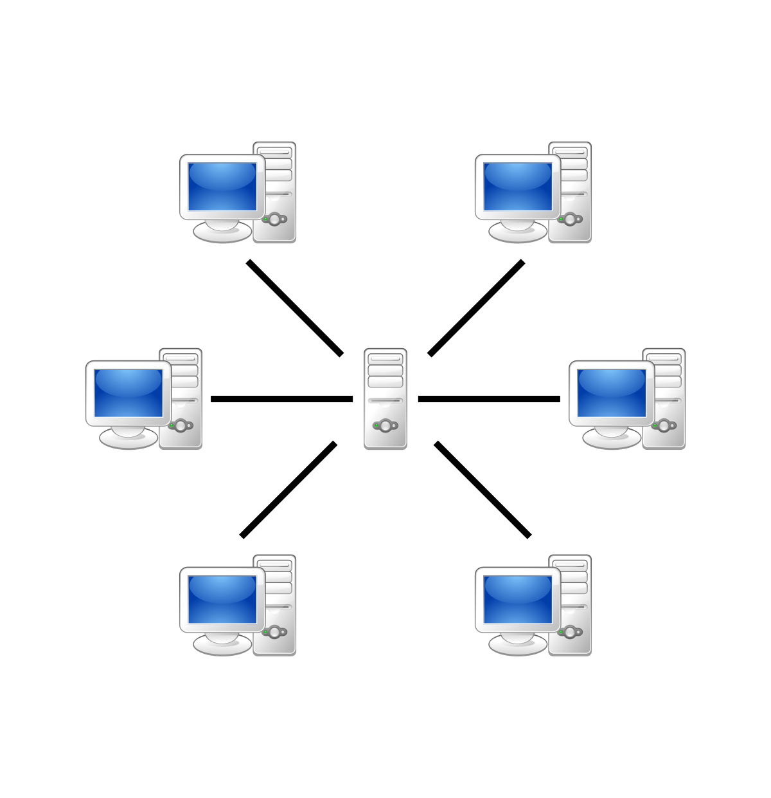
Type of LAN: Client/server Networks
Made up of one or more file servers and clients (any type of computer)
Client software enables requests to be sent to the server
Wired or wireless connections
Do not slow down with heavy use

Slide 9
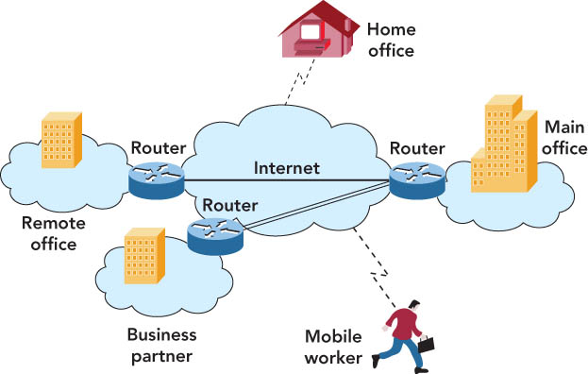
Other types of Local Area Networks
Intranet
Password-protected network controlled by the company
Accessed only by employees
Virtual private network
Operates over the Internet
Accessible by authorized users for quick access to corporate information
Uses secure, encrypted connections and special software

Slide 10
Local Area Network Topologies
A network topology is the physical design of a LAN
Topology can resolve contention, the conflict that occurs when two or more computers on the network attempt to transmit at the same time
Contention sometimes results in collisions, the corruption of network data caused when two computers transmit at the same time

Slide 11
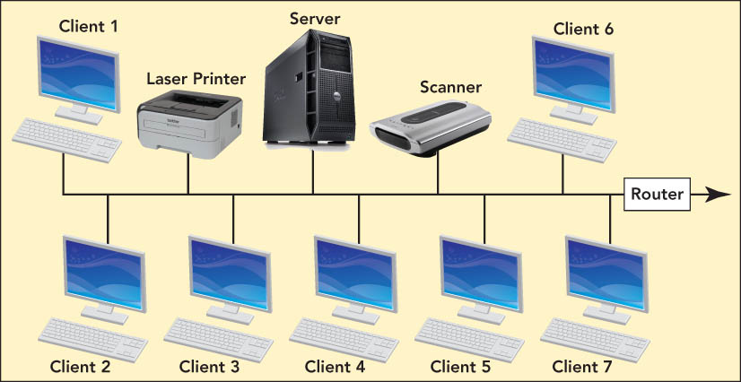
Types of Topologies
Bus Topology
Practical for home or small office
One node transmits at a time
Terminators signify the end of the circuit
Uses contention management
technique that specifies what happens when a collision occurs

Slide 12
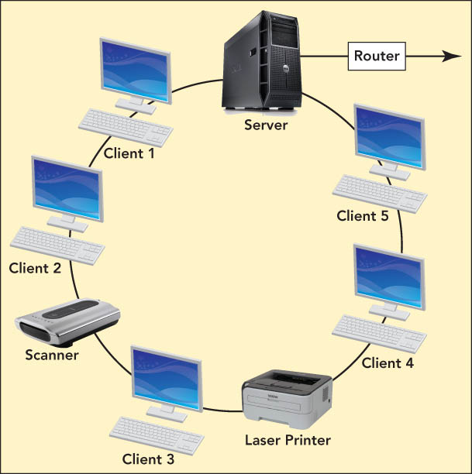
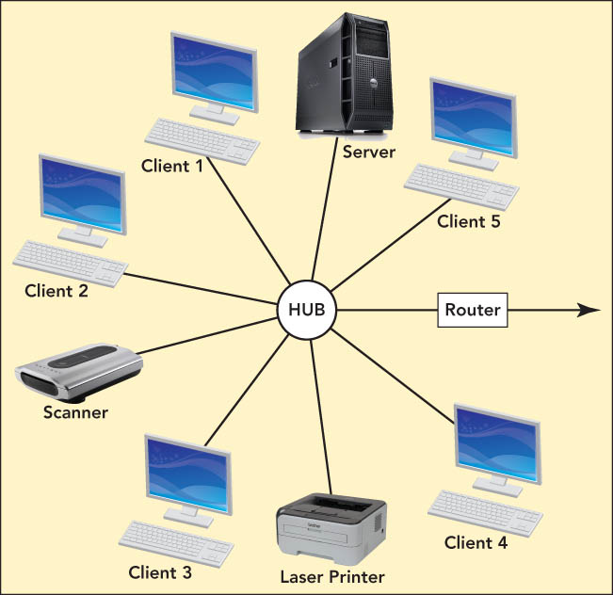
Types of Topologies
Ring topology
For a division of a company or one floor
Not in common use today
Node can transmit only when it has the token
special unit of data that travels around the ring
Star topology
For office buildings, computer labs, and WANs
Easy to add users
Most common and widely implemented

Slide 13
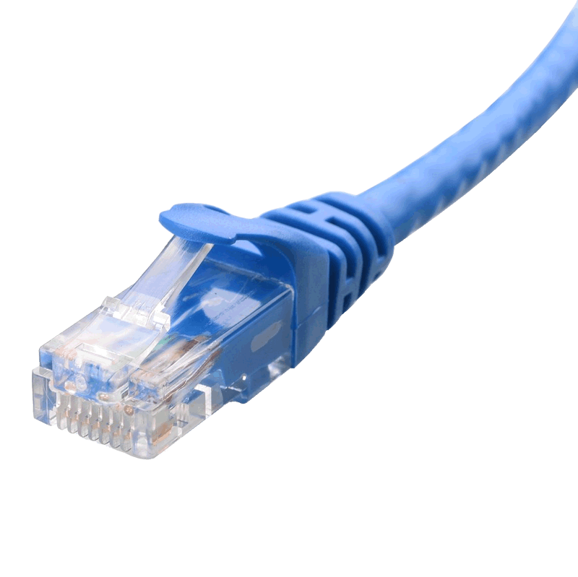

LAN technologies
Ethernet
Most popular: Ethernet star networks
Faster bandwidth
Wi-Fi
Uses radio waves to provide a wireless LAN standard at (close to) Ethernet speeds
Needs a central access point—could be a wireless router
Higher latency
Higher interference
Less secure

Slide 14
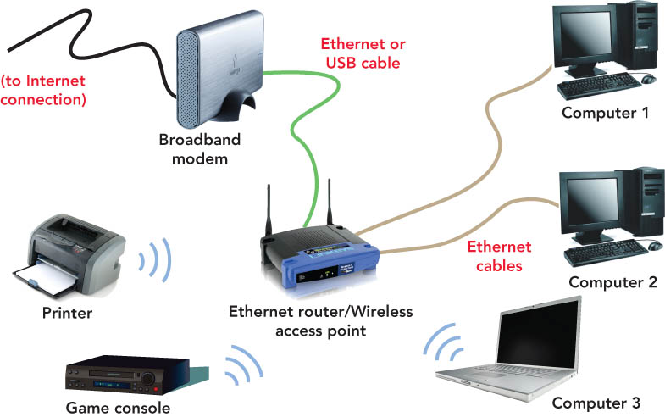
Example LAN: Home Networks
Can be wired, wireless, or a combination of both technologies

Slide 15
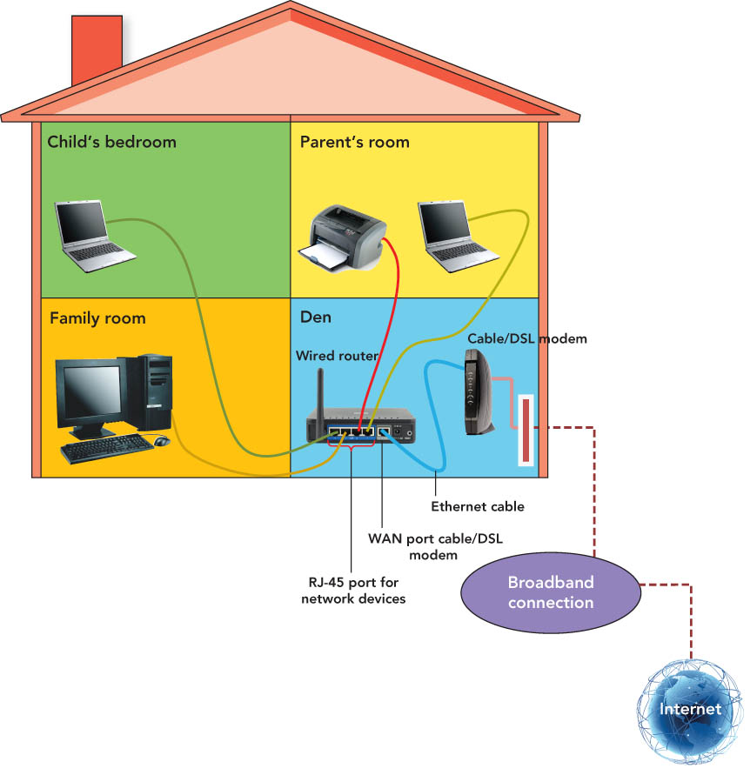
Example LAN: Wired Home Network

Slide 16
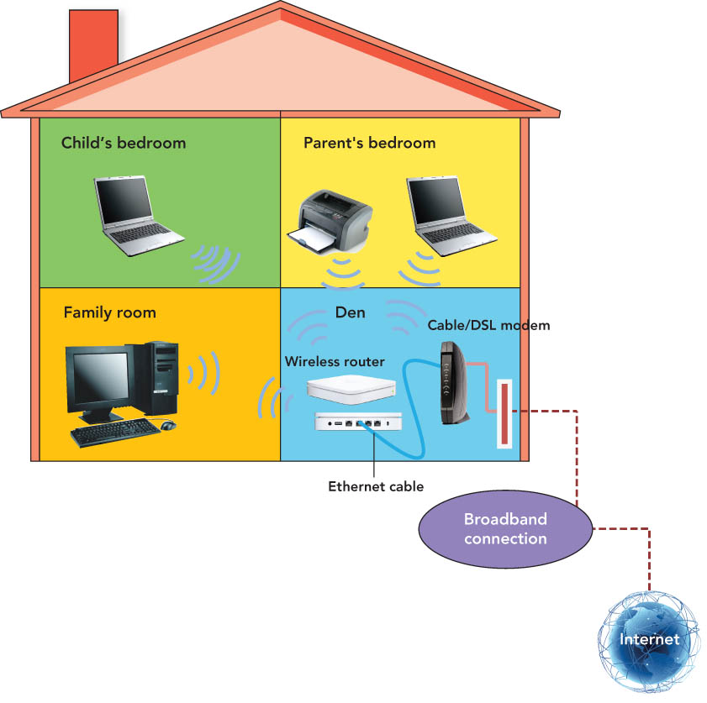
Example LAN: Wireless Home Network

Slide 17
Future of home networking
Convergence will allow you to use home networks to
Control and manage household devices
Appliances
Entertainment
Temperature regulation
Lighting
Protect homes with security systems

Slide 18
Wide Area Networks (WAN)

Slide 19
Wide Area Networks
Point of presence (POP)
WAN connection point used to obtain access to the WAN
Wired or wireless
Backbones
High-capacity WAN transmission lines
gigaPoP (gigabits per second point of presence)
transfers data exceeding 1 Gbps (1 billion bits per second)

Slide 20
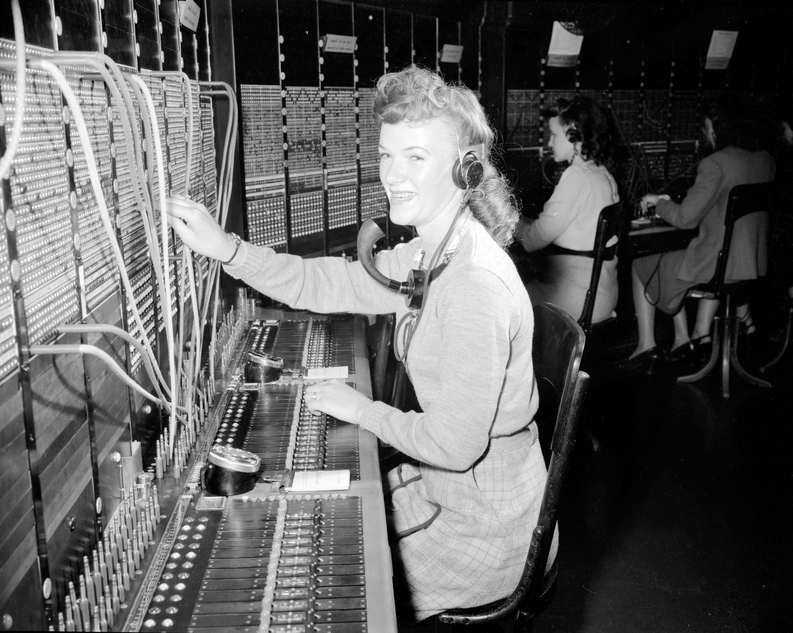
WAN protocols
Circuit switching
Provides a direct connection between devices
Used by the public switched telephone network to send data over a physical end-to-end circuit
Packet switching
Used for computer communication
Divides and sends outgoing messages as packets, which are reassembled on receipt
More efficient and less expensive than circuit switching
Latency—delay introduced when a given packet is examined by many routers
Congestion—occurs when the network is overloaded, causing some packets to be further delayed

Slide 21
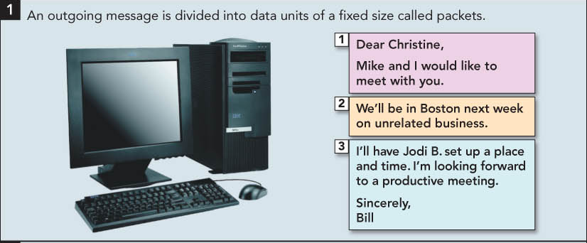
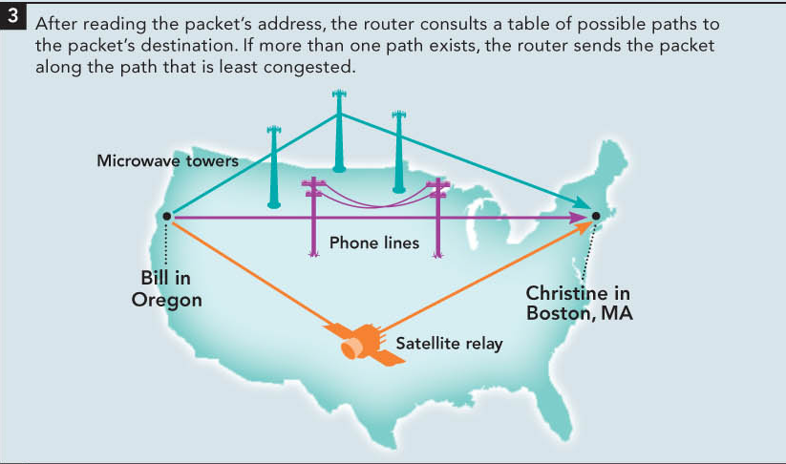
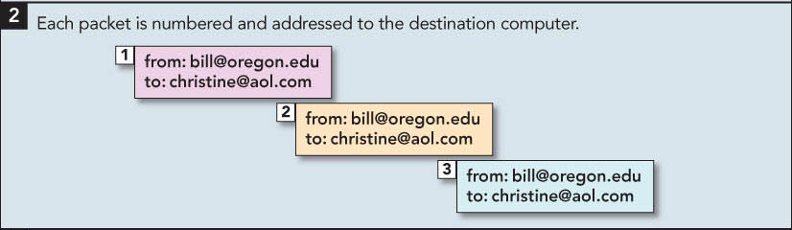
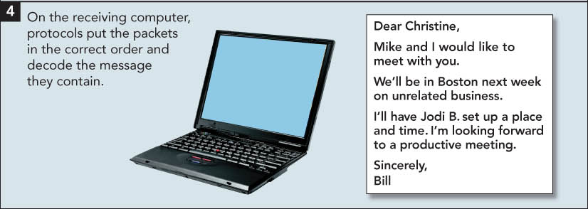

Slide 22
WAN applications
E-mail, conferencing, document exchange, remote database access
LAN to LAN connections connect two or more geographically separate locations
Transaction acquisition—the instant relay of transaction information from a point-of-purchase sale.

Slide 23
Advantages and Disadvantages of Networking
Advantages
Information sharing
Resource sharing
Collaboration
Reduced costs (e.g., software licenses)
Connecting people
Disadvantages
Security threats
Lack of privacy
Loss of autonomy
Can be expensive (e.g., cable, file servers, ISP)
Can be addictive

